Slide 1

Basic Hardware
By Fionn Hourican

Slide 2
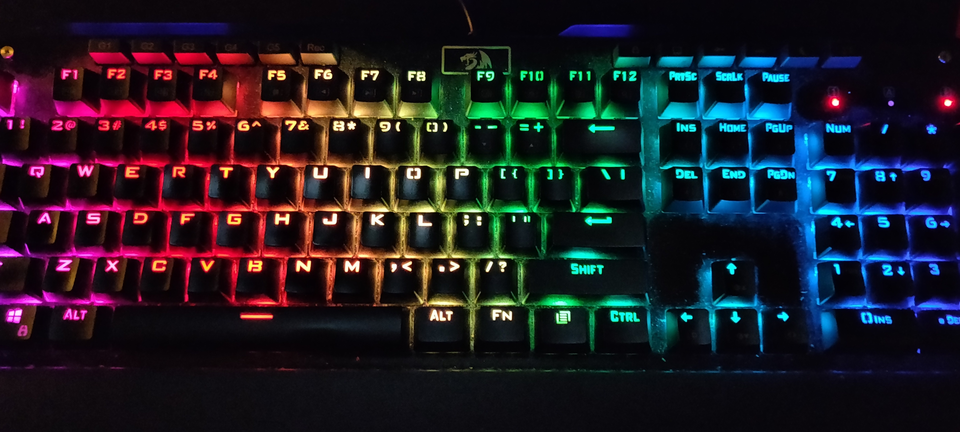
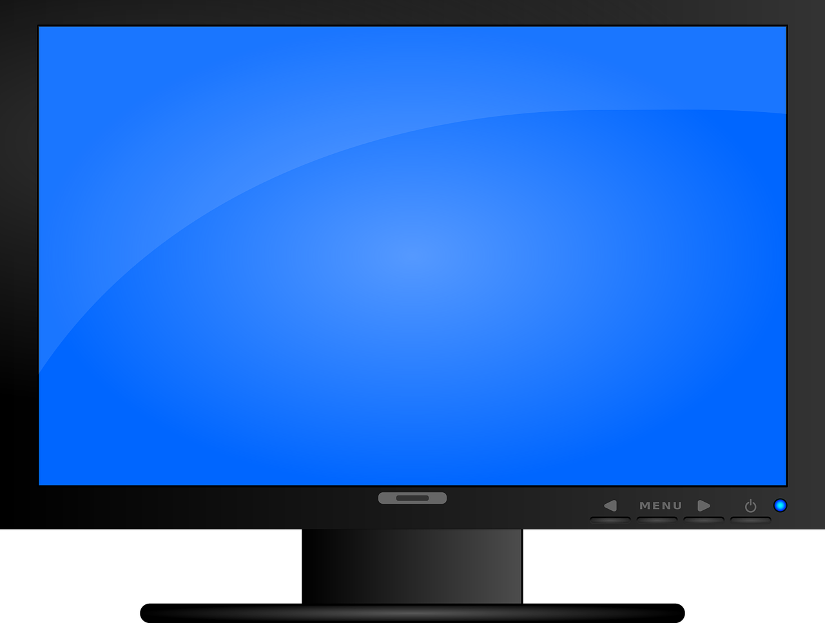
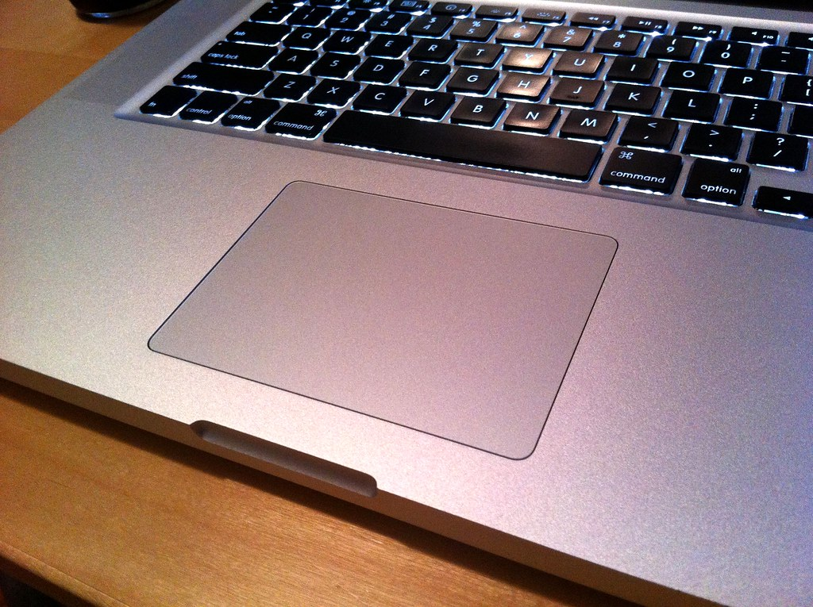
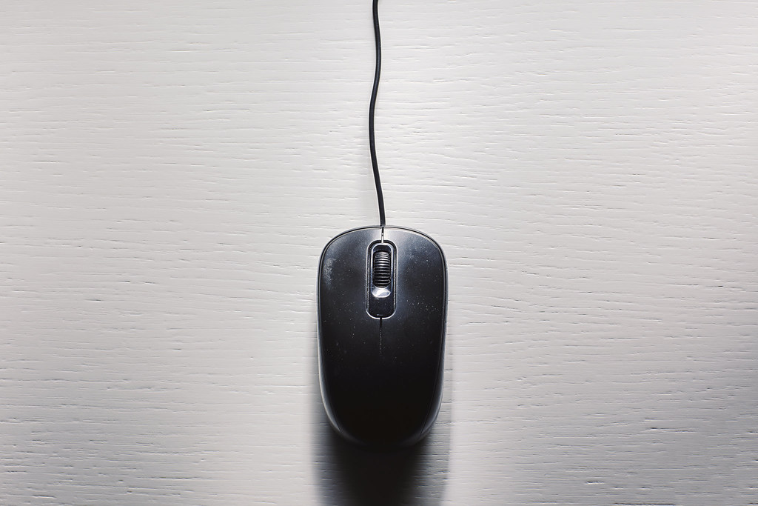
The mouse, keyboard & monitor
Image: Computer keyboard rainbow commons.Wikimedia.org
Image: Glass trackpad flickr.com
Image: Mouse flickr.com
Image: pc monitor - Free vector graphic on Pixabay pixabay.com

Slide 3
The monitor

Slide 4
What is a computer monitor?
The computer monitor is the main output hardware of the computer
It displays pictures, videos and text in real time to allow the user to interact with the computer(wiltronics 2021)
The monitor is made up of the screen, power supply and may have buttons for changing display settings e.g. brightness

Slide 5
How does a computer monitor work?
Monitors work by displaying information processed by the computer’s video card. The result of the processing displayed by the monitor is called output.(Wiltronics 2021)
The information which is processed by the video card comes from input devices, such as the mouse and keyboard.

Slide 6
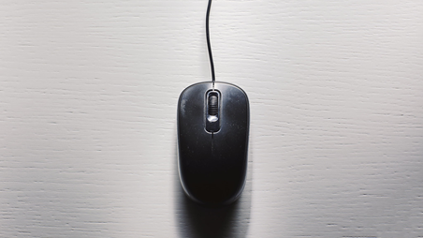
What is the mouse?
The mouse is an input device that lets you control a range of things on a computer.
It does this by pointing the cursor/pointer at a program (e.g., google) & clicking the left button to open the program
The “cursor” or “pointer” is usually an arrow shape, which is moved around by dragging the mouse. It may change shape when over text or a link to a web page. It becomes a hand over a link to a web page and a capital i (I) over text, the capital I will flash when you can type.(beconnected 2021)

Slide 7
The buttons on a mouse
Pressing down the right button on the mouse is called a “right click”.
Pressing down on the left button on the mouse is called a “left click”
Most mouses have a “scroll bar” in-between the left and right buttons

Slide 8
Difference between “left click” & “right click”
“Left click”
“Right click”
Left clicking is used to select.
Right-click often makes a menu appear with choices that apply to the current selection or program.(office watch 2018)
For example, in “PowerPoint” when you right click a menu pops up with shortcuts. You then use the left click to select what action you want to make.

Slide 9
The keyboard: An input device

Slide 10
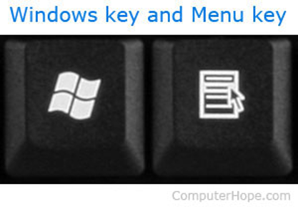
What are keys?
The buttons on the keyboard are called keys.
They consist of letters, numbers, symbols and function keys
When a key is pressed it sends an input int the computer which appears on the screen. (computer hope 2021)

Slide 11
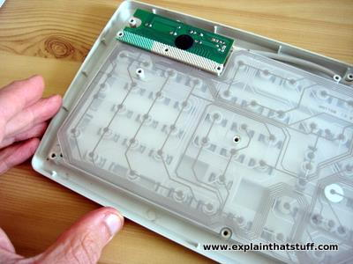
Whats under the keys?
Transparent plastic contact layers detect key presses and through the layers you can see the round bars poking the keys down from above.
The green rectangle at the top contains three small LEDS (lights) that activate the indicator lights for "Num lock", "Caps lock", and "Scroll lock".
The cable running along the inside of the case at the top of the keyboard carries electrical signals from the keyboard to your computer's USB port (Woodford C, 2020)

Slide 12
Sources
beconnected, 2021, what is a mouse?, https://beconnected.esafety.gov.au/topic-library/essentials/the-absolute-basics/what-is-a-computer/what-is-a-mouse#
Office watch, 2018, Left and Right mouse buttons, what's the difference?, https://office-watch.com/2018/left-and-right-mouse-buttons-whats-the-difference/
Woodford C, 30/10/2021, Computer Keyboards, https://www.explainthatstuff.com/computerkeyboards.html
Wiltronics, 2021, what is a computer monitor?, https://www.wiltronics.com.au/wiltronics-knowledge-base/how-does-a-computer-monitor-work/

